Slide 1
Prompt engineering

Slide 2
Why and what's Prompt Engineering
Elements of a Prompt
Introduction to Prompt Engineering
Demo
Designing Prompts for Different Tasks

Slide 3
Why Prompt Engineering
Effective prompt engineering in large language models can:
Improve coherence: By providing a well-constructed prompt, the generated text can be more coherent and logically connected.
Control output: Prompts can be used to control the output of the model and generate text that is more relevant to a specific task or topic.
Enhance creativity: Prompts can be designed to encourage the model to generate more creative and interesting responses.
Guide model behavior: Prompts can be used to guide the model's behavior towards specific goals or objectives, such as summarization or question-answering.
Enables all kinds of innovative applications on top of LLMs

Slide 4
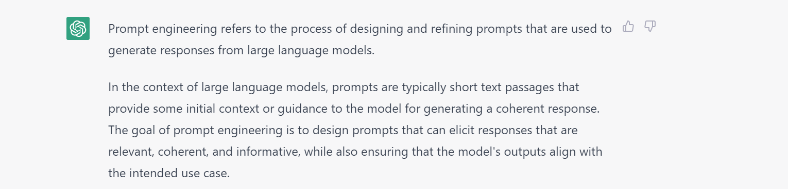
What Prompt Engineering
Prompts involve instructions and context passed to a language model to achieve a desired task
Prompt engineering is the practice of developing and optimizing prompts to efficiently use Large Language Models (LLMs) for a variety of applications
Prompt engineering is a useful skill for AI engineers and researchers to improve and efficiently use Large Language Models

Slide 5

First basic prompt
Instruction
Response

Slide 6
What Prompt Engineering
A prompt is composed with the following components:
Instructions
Context
Input data
Output indicator
instruction = """Answer the question based on the context below.
If the question cannot be answered using the information provided answer with "I don't know".
Context: Large Language Models (LLMs) are the latest models used in NLP. Their superior performance over
smaller models has made them incredibly useful for developers building NLP enabled applications.
These models scan be accessed via Hugging Face's `transformers` library, via OpenAI using the
`openai` library, and via Cohere using the `cohere` library.
User input or a query : Which libraries and model providers offer LLMs?
Answer: """

Slide 7
Settings to keep in mind
When prompting a language model, you should keep in mind a few settings
You can get very different results with prompts when using different settings
One important setting is controlling how deterministic the model is when generating completion for prompts
Temperature and top_p are two important parameters to keep in mind
Generally, keep these low if you are looking for exact answers, and keep them high if you are looking for more diverse responses

Slide 8
Designing prompts for different Tasks
In the next few slides, we will cover a few examples of common tasks using different prompts Tasks covered:
Text summarization
Question answering
Text classification
Role playing
Code generation
Reasoning

Slide 9

Text summarization

Slide 10
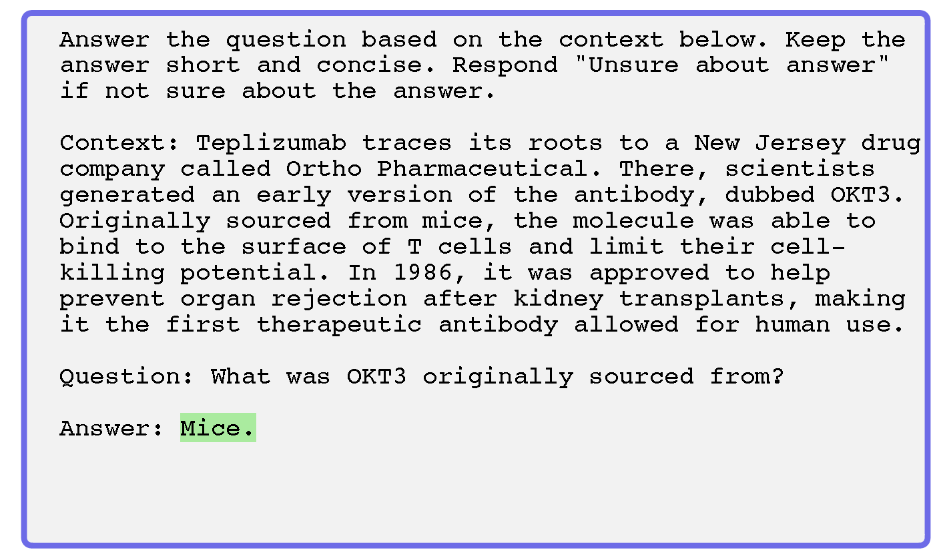
Question answering

Slide 11
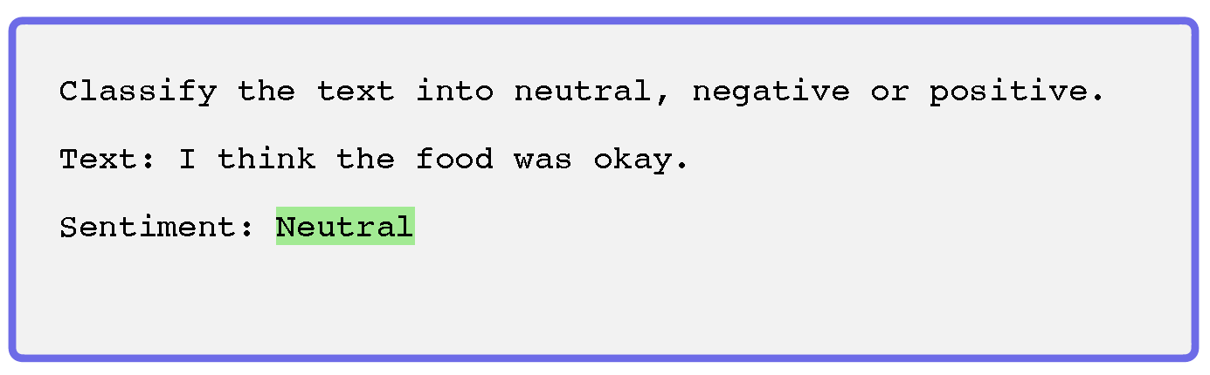
Text classification

Slide 12
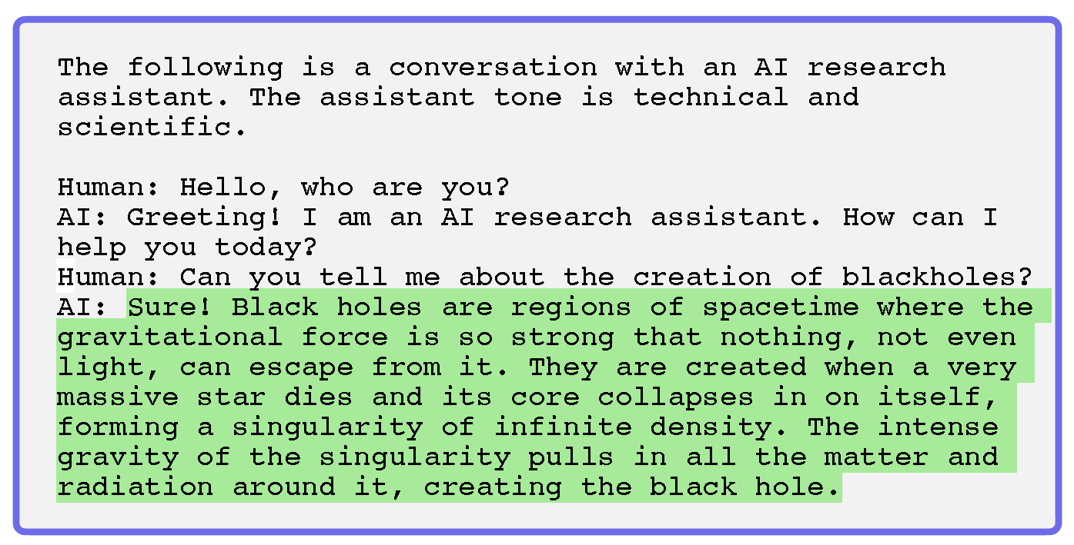
Role Playing

Slide 13
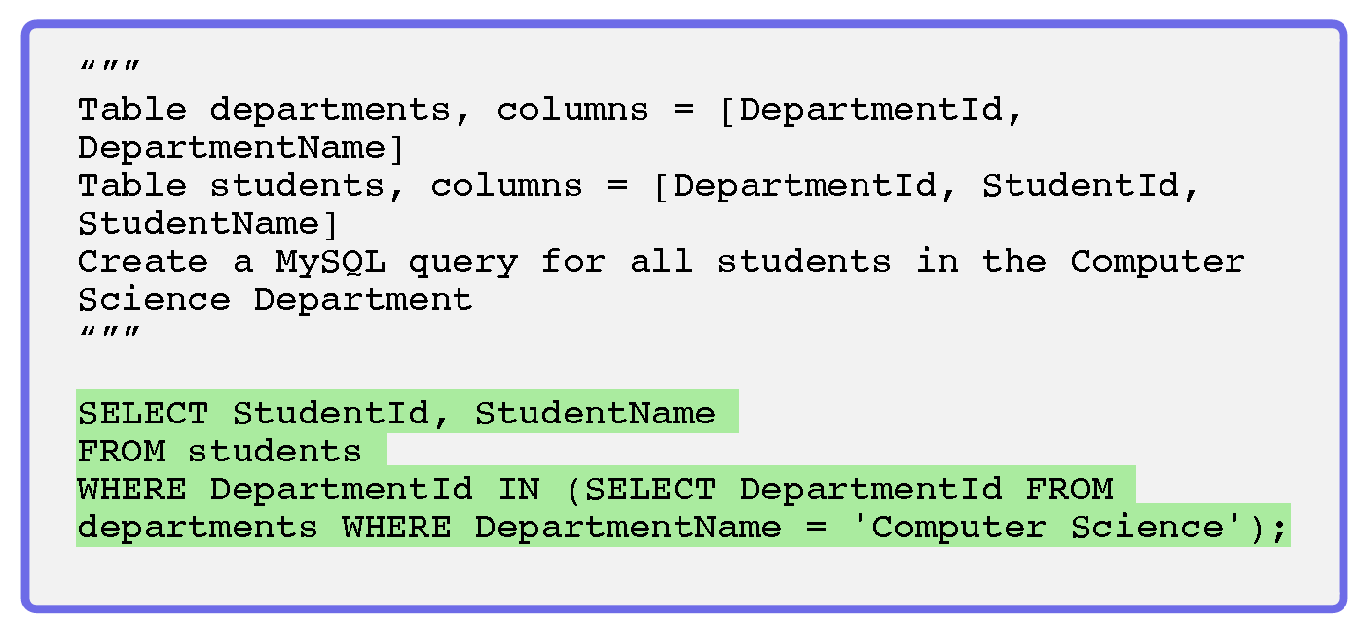
Code Generation

Slide 14
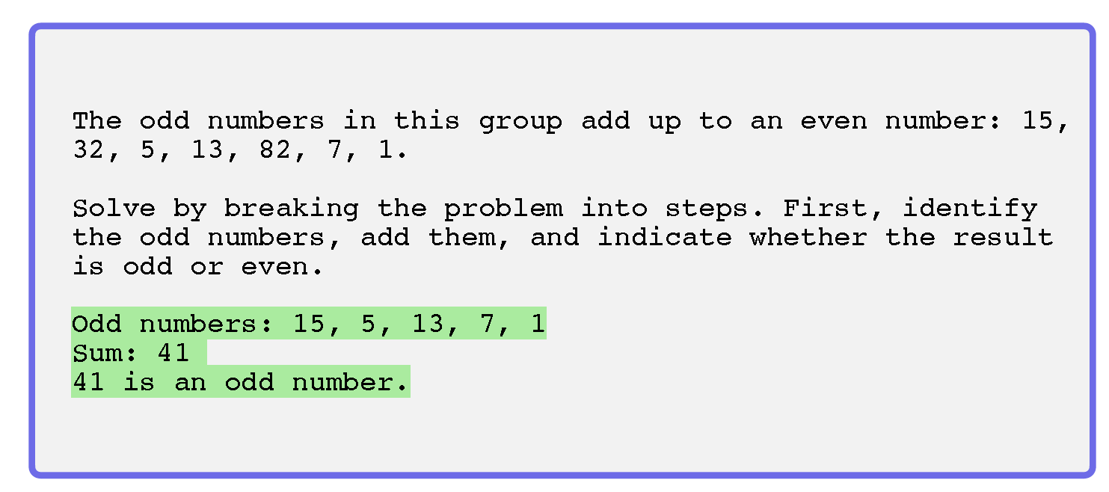
Reasoning

Slide 15
Lab #1 - Hands-on with Prompt Engineering Exercises

Slide 16
Few-shot prompts
Chain-of-thought (CoT) prompting
Advanced techniques for prompt engineering
Knowledge Generation Prompting
Self-Consistency
ReAct

Slide 17
Prompt engineering techniques
Many advanced prompting techniques have been designed to improve performance on complex tasks
Few-shot prompts
Chain-of-thought (CoT) prompting
Self-Consistency
Knowledge Generation Prompting
ReAct

Slide 18
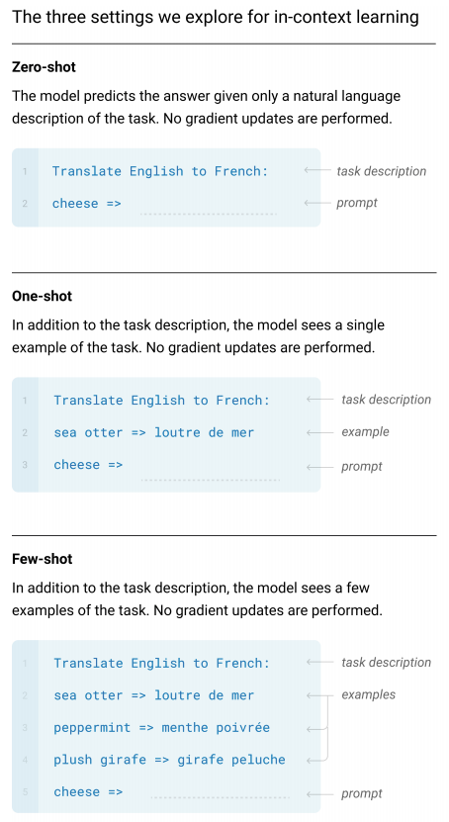
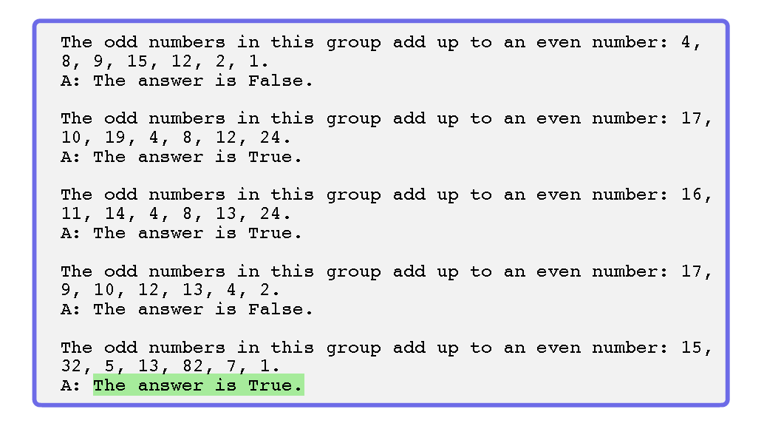
Few-shot prompts
Few-shot prompting allows us to provide exemplars in prompts to steer the model towards better performance

Slide 19
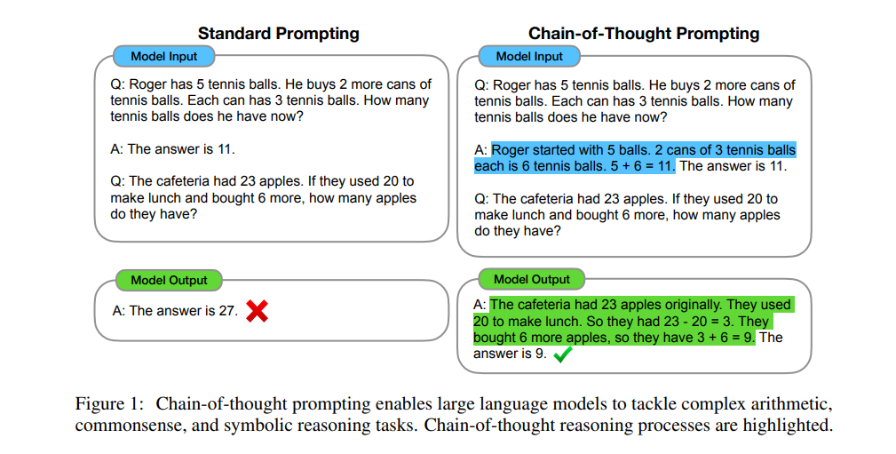
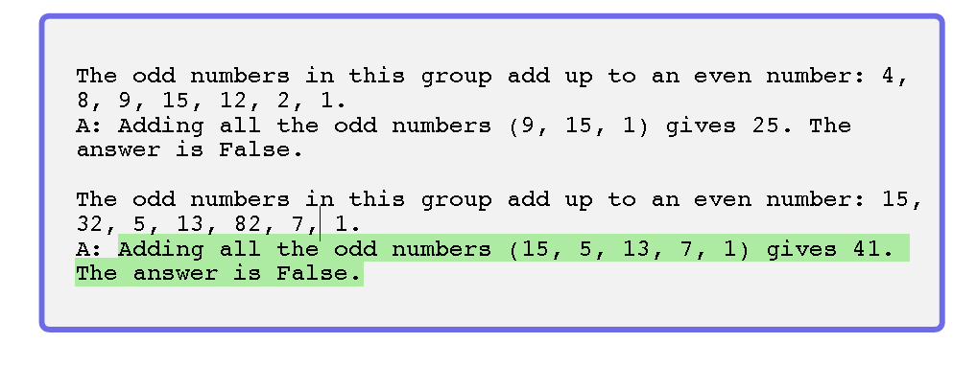
Chain-of-thought (CoT) prompting
Prompting can be further improved by instructing the model to reason about the task when responding
This is very useful for tasks that requiring reasoning
You can combine it with few-shot prompting to get better results
You can also do zero-shot CoT where exemples are not available
Notes:
Source: Chain-of-Thought Prompting Elicits Reasoning in Large Language Models

Slide 20
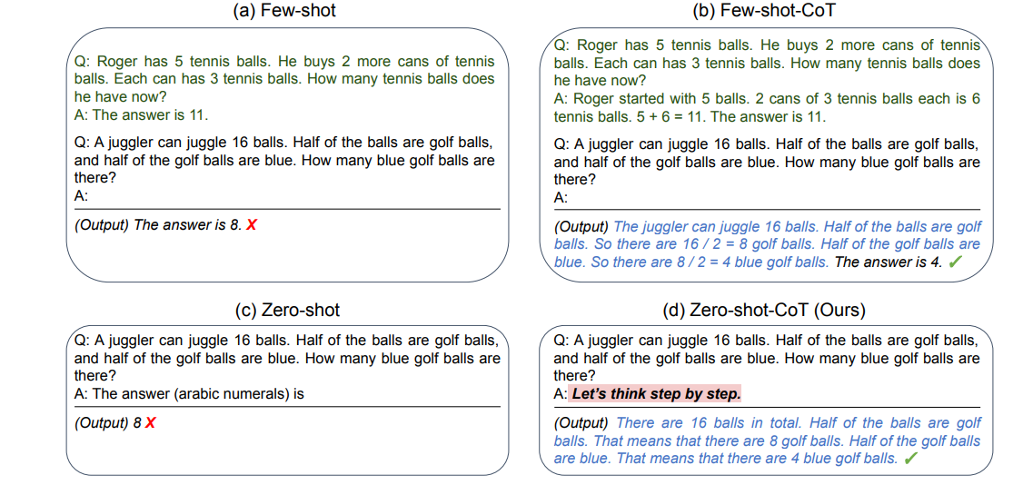
Zero-shot Chain of Thought
Involves adding "Let's think step by step" to the original prompt
Source: Large Language Models are Zero-Shot Reasoners

Slide 21
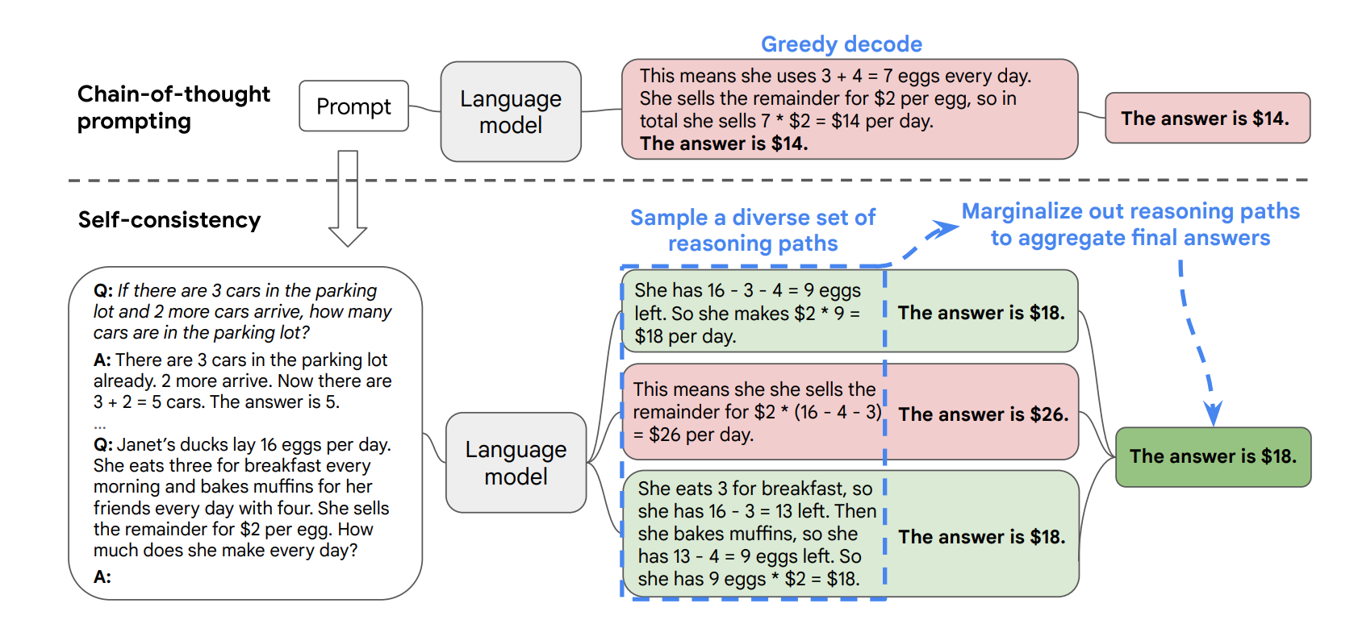
Self-consistency
Self-Consistency aims to improve on the naive greedy decoding used in chain-of-thought prompting
The idea is to sample multiple, diverse reasoning paths through few-shot CoT, and use the generations to select the most consistent answer.
This helps to boost the performance of CoT prompting on tasks involving arithmetic and commonsense reasoning
Source: Self-Consistency Improves Chain of Thought Reasoning in Language Models

Slide 22
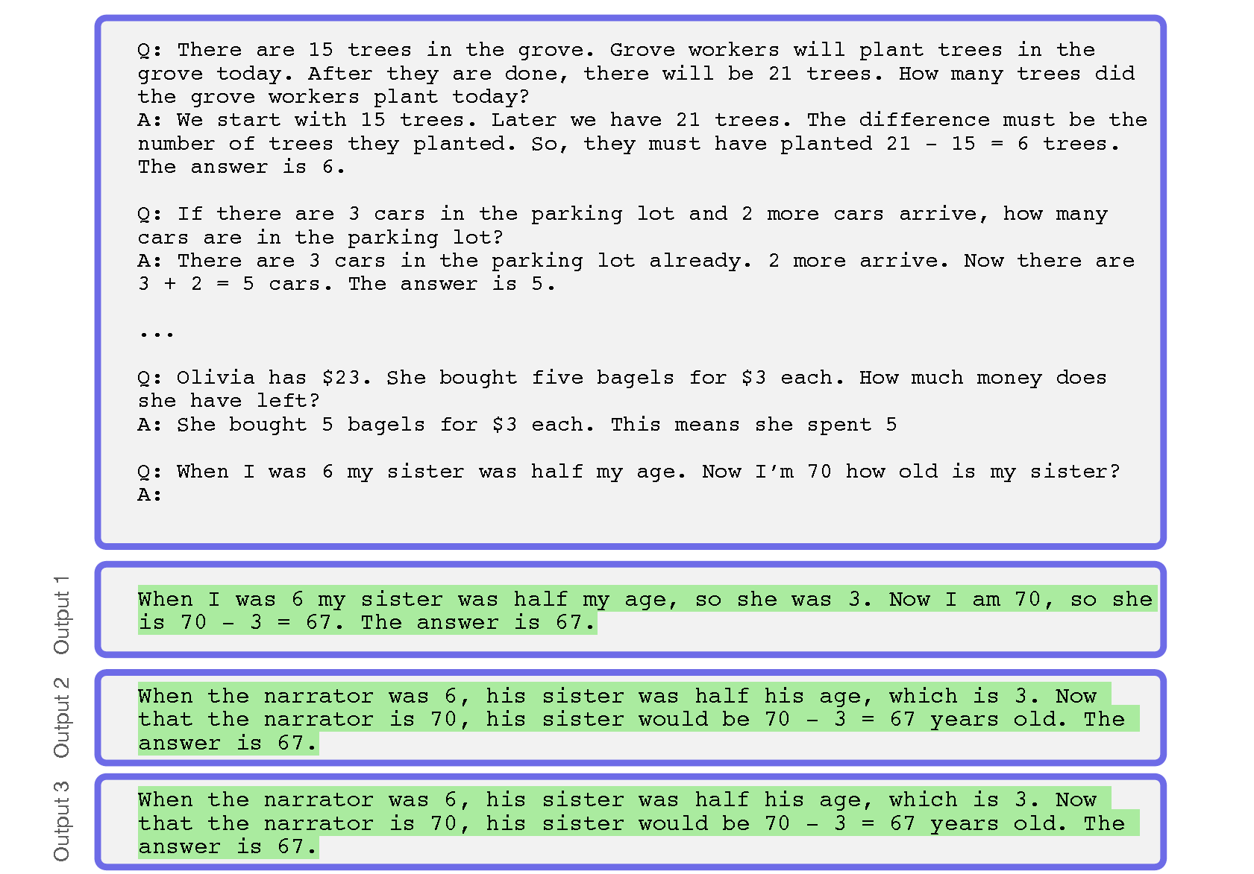
Self-consistency example

Slide 23
Generate knowledge prompting
This technique involves using additional knowledge provided as part of the context to improve results on complex tasks such as commonsense reasoning
The knowledge used in the context is generated by a model and used in the prompt to make a prediction
Highest-confidence prediction is used
Source: Generated Knowledge Prompting for Commonsense Reasoning

Slide 24
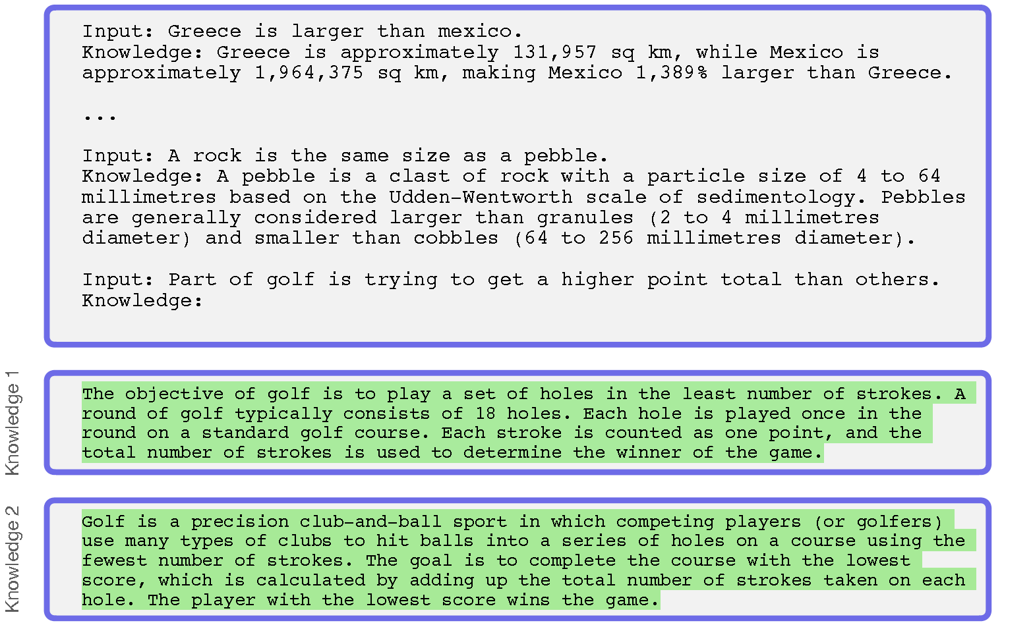
Generate knowledge prompting example
The first step is to generate knowledge. Below is a example of how to generate the knowledge samples

Slide 25
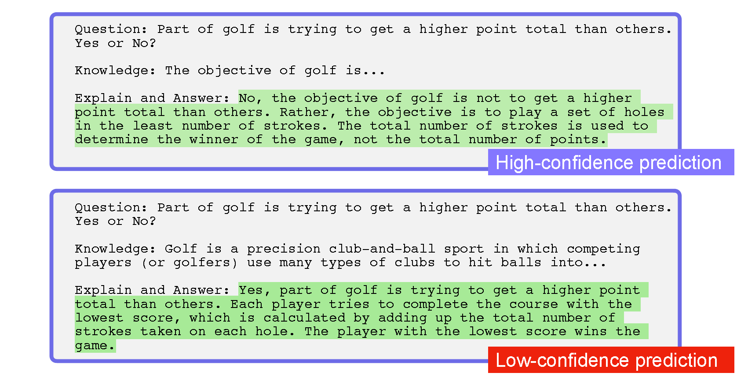
Generate knowledge prompting example
The knowledge samples are then used to generate knowledge augmented questions to get answer proposals
The highest-confidence response is selected as final answer

Slide 26
ReAct
ReAct is a framework where LLMs are used to generate both reasoning traces and task-specific actions in an interleaved manner
Generating reasoning traces allow the model to induce, track, and update action plans, and even handle exceptions
The action step allows to interface with and gather information from external sources such as knowledge bases or environments.
ReAct allows LLMs to interact with external tools to retrieve additional information that leads to more reliable and factual responses

Slide 27
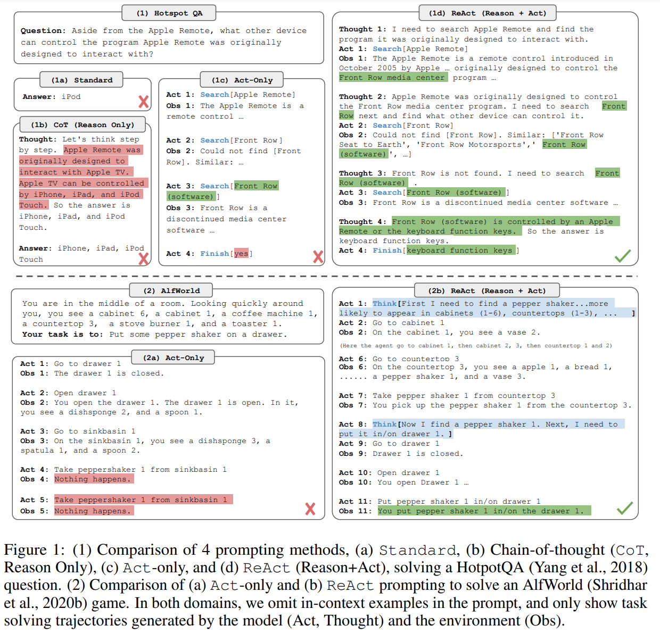
ReAct
Source: ReAct: Synergizing Reasoning and Acting in Language Models

Slide 28
Demo - Exploring ReAct with Langchain

